Slide 1
Importing & Securing Data In Servicenow
SlideMake.com

Slide 2
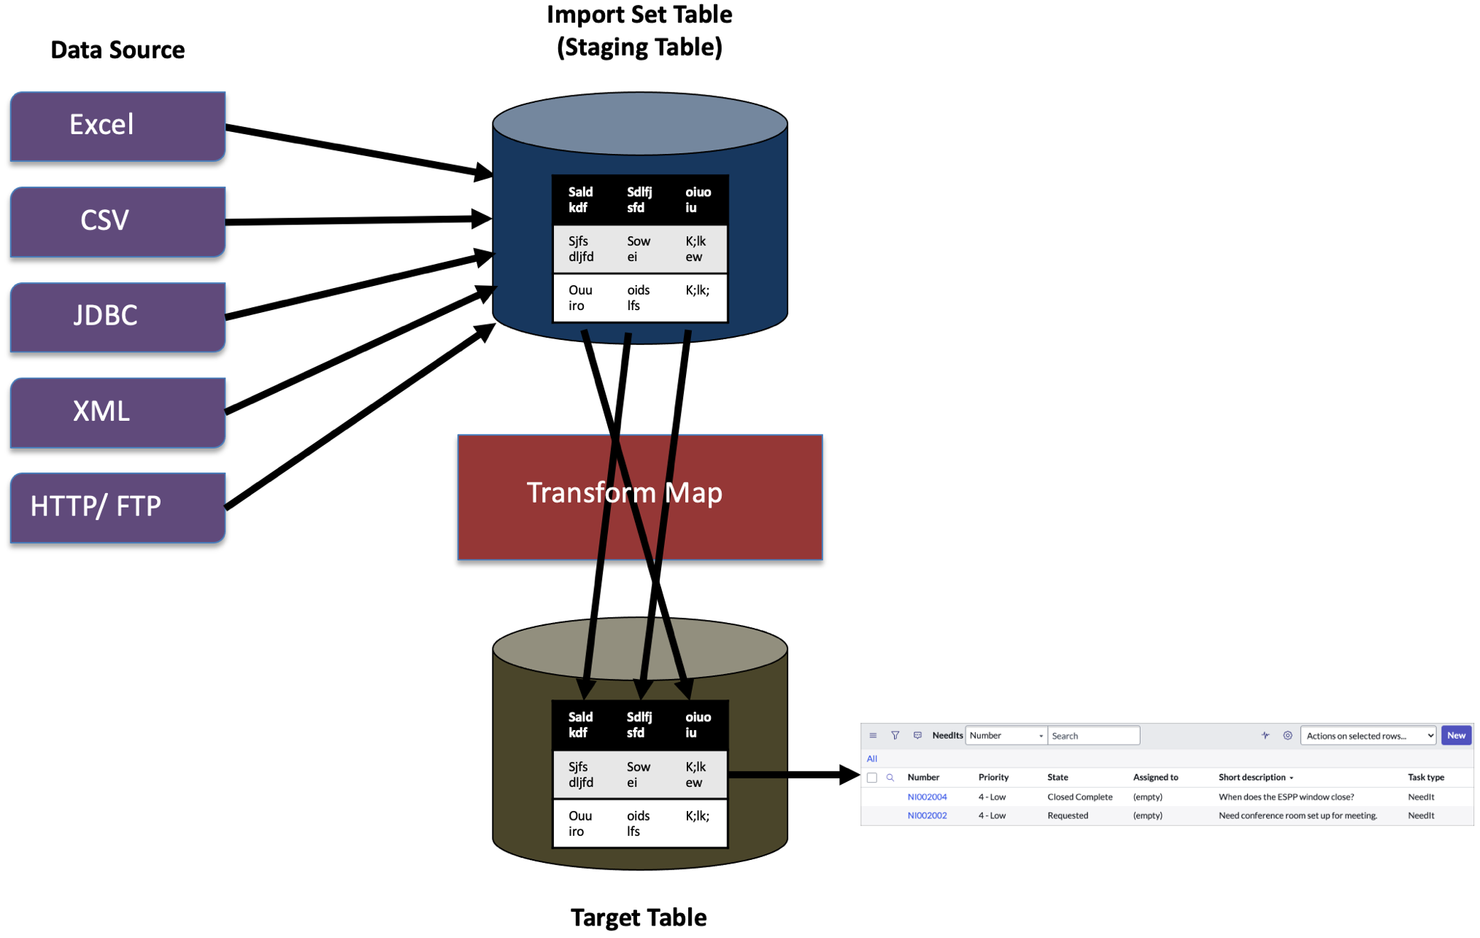
Introduction to Importing & Securing Data in ServiceNow
Importing data is essential for populating and updating ServiceNow records efficiently.
Securing data ensures sensitive information remains protected from unauthorized access.
Proper management of both processes enhances data integrity and compliance within the platform.
Notes:
Image source: https://developer.servicenow.com

Slide 3
Common Data Import Methods in ServiceNow
Data can be imported using Import Sets, which transform raw data into ServiceNow records.
Integration with external systems via APIs allows real-time data synchronization.
Data uploads can also be performed through CSV, Excel, or XML files for bulk imports.
Notes:
Image source: https://developer.servicenow.com

Slide 4
Preparing Data for Import
Data should be cleaned and validated to prevent errors during the import process.
Mapping fields correctly ensures data aligns with existing ServiceNow table structures.
Creating a data schema or template helps streamline repetitive imports.
Notes:
Image source: https://developer.servicenow.com

Slide 5
Import Set Configuration and Usage
Import Sets allow admins to define data sources and target tables precisely.
Transform Maps are used to customize data transformation rules during import.
Running Import Sets can be scheduled or executed manually depending on business needs.
Notes:
Image source: https://developer.servicenow.com

Slide 6
Automating Data Imports with IntegrationHub
IntegrationHub enables automated, scalable integrations with third-party systems.
Spokes and flows facilitate seamless data transfer and process automation.
Automations reduce manual effort and minimize data entry errors.
Notes:
Image source: https://developer.servicenow.com

Slide 7
Data Security Best Practices in ServiceNow
Use role-based access controls (RBAC) to restrict data visibility appropriately.
Encrypt sensitive data at rest and in transit to prevent unauthorized access.
Regularly audit access logs to monitor and respond to suspicious activities.
Notes:
Image source: https://developer.servicenow.com

Slide 8
Securing Data Through Access Controls
Define ACLs (Access Control Lists) at the table, field, or record level.
Use conditions and scripts within ACLs to enforce complex security policies.
Limit administrative privileges to trusted personnel to reduce security risks.
Notes:
Image source: https://developer.servicenow.com

Slide 9
Data Masking and Encryption Techniques
ServiceNow offers data masking features to hide sensitive information on forms and reports.
Use encryption for fields containing personally identifiable information (PII).
Implement multi-factor authentication (MFA) for users accessing sensitive data.
Notes:
Image source: https://developer.servicenow.com

Slide 10
Best Practices for Maintaining Data Security
Regularly review and update security policies to adapt to evolving threats.
Backup data routinely to prevent loss and facilitate recovery.
Educate users on security procedures and the importance of data protection.
Notes:
Image source: https://developer.servicenow.com

Slide 11
Conclusion and Summary
Effective data importing and securing practices are vital for platform reliability.
Leveraging ServiceNow’s built-in tools enhances data accuracy and security.
Continuous monitoring and updating of security measures help maintain compliance.
Notes:
Image source: https://developer.servicenow.com

Slide 12
References
ServiceNow Product Documentation. (2023). Import Sets and Data Management.
ServiceNow Security Best Practices. (2023). Data Security and Privacy.
ServiceNow Community and Knowledge Articles. (2023). Data Import and Security Tips.

